Slide 1
Section 3.2
JSR and CALL Instructions

Slide 2
JSR – Jump to Subroutine
3 byte instruction
First byte is opcode
Bytes 2 and 3
Address range is 0000 – FFFF H
The address of instruction below jump is saved to stack
Upon subroutine fetch, PC of next instruction saved to stack and control passes to subroutine
RTS returns control to calling program

Slide 3
; This program toggles all of the bits of Port B by sending 55 H and AA H repeatedly
; A time delay is provided between each data write
INCLUDE ‘nc9s12dp512.inc’
MYREG EQU $8O8 ; LOCATION 808 STORES COUNTER
ORG $8000 ; STARTING ADDRESS
LDS #$4000 ;INITIALYZE STACK POINTER
BACK LDAA #$55 ; A = 55 H
STAA PORTB ; SEND 55H TO PORTB
JSR DELAY ; JUMP TO DELAY SUBROUTINE
LDAA #$AA ; A = AA H
STAA PORTB ; SEND AA H TO PORTB
JSR DELAY ; JUMP TO DELAY SUBROUTINE
BRA BACK ; INFINITE LOOP
; Time Delay Subroutine
ORG $8300 ; PUT TIME DELAY AT ADDRESS 8300 H
DELAY LDAA #$FF ; A = 255 D
STAA MYREG ; MYREG = FF H
AGAIN NOP
NOP ; 2 CLOCK CYCLES ARE WASTED
DEC MYREG ; DECREMENT COUNTER
BNE AGAIN ; LOOP UNTIL COUNTER IS 0
RTS ; RETURN TO CALLER
END ; END OF ASM FILE

Slide 4
JSR Instruction and Role of Stack
Stack saves address below JSR instruction
RTS will return to the instruction below the JSR instruction
Upon executing the first JSR, address of LDAA #$AA is pushed onto the stack and instructions starting at 8300 H commence
The counter is set to 255 D within the DELAY subroutine which is therefore executed 255 times
When counter equals 0 control is transferred to RTS instruction
Actual time delay dependent on clock rate

Slide 5
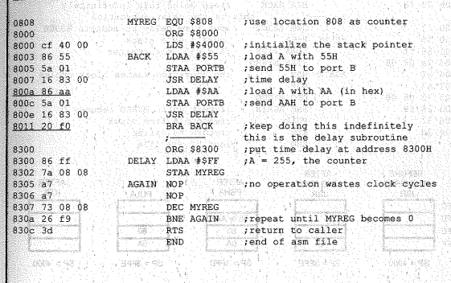
List file for previous program

Slide 6
Memory Map and SP Before and After JSR
Address | Before First JSR | After First JSR | After RTS | After Second JSR | After RTS
3FFC
3FFD
3FFE |  | 80 |  | 80
3FFF |  | 0A |  | 11
SP VALUE | 4000 | 3FFE | 4000 | 3FFE | 4000

Slide 7
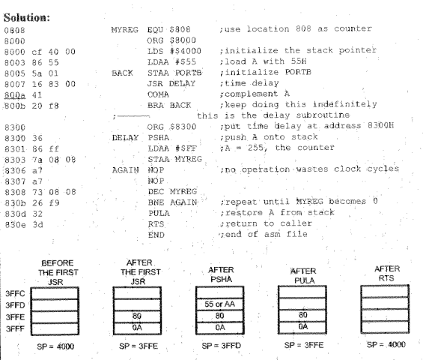
Using Complement A to do the same thing as previous example

Slide 8
Stack Usage and its Lower Limit
Stack is most often used for Calls and Interrupts.
Stack keeps track of where CPU should return after completing subroutine
Be careful about manipulating Stack Contents
Could cause unexpected results
Also make sure stack does not reach lowest address
This can happen if we have too many nested calls

Slide 9
Calling Many Subroutines from Main
It is common and good practice to call subroutines from the main program
Allows development and debug at subroutine level
Allows development of subroutine by different programmer
This reduces the code development interval

Slide 10
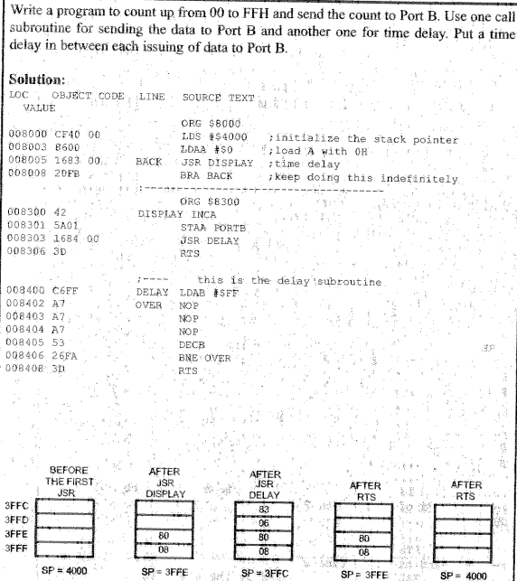
Another List Example

Slide 11
Call
On chip ROM on HCS12 can exceed 512 Kbyte
Use of CALL will allow access out of 64 KB space
Accessing Flash ROM outside of 64 KB address range requires use of PPAGE register
Call is a 4 Byte Instruction
Target address of subroutine may be within 512 Kbytes of CALL
One byte of command is for PPAGE value
Call uses 3 bytes of stack
Use RTC to return from CALL

Slide 12
Calling Many Subroutines
; Main Program Calling Subroutines
INCLUDE ‘mc9s12dp512.inc’
ORG $8000
LDS #$4000 ; Initialize Stack Pointer
; Other Instructions may be here
MAIN JSR SUBR1
; Other Instructions may be here
JSR SUBR2
JSR SUBR3
HERE BRA HERE ; Stay here
; End of Main
SUBR1 ; Some code
RTS
SUBR2 ; Some code
RTS
SUBR3 ; Some code
RTS
END ;End of asm file

Slide 13
CALL vs. JSR
Assume your particular HCS12 is equipped with 32K on chip Flash ROM.
Which command would you use?
JSR is 3 byte instruction and saves ROM
We do not need to use CALL because we will not go out of 64 KB range

Slide 14
Delay Calculation for HCS12
Two factors affect accuracy of delay
Crystal Frequency
Connected to XTAL AND EXTAL pins
Internal Design of the HCS12
Three ways to reduce number of clock cycles per instruction
Harvard Architecture
RISC Architecture
Pipelining – Used extensively in HCS12 due to backward compatibility reasons

Slide 15
HCS12 Call Instruction Summary
Instruction | Action | Instruction Size
JSR | Branch to an address within 64 Kbytes | 3 byte
BSR | Branch to an address within 256 Kbytes | 2 byte
RTS | Return from subroutine, used with JSR and BSR | 1 byte
CALL | Call an address beyond 64 Kbyte | 4 byte
RTC | Return from subroutine in expanded memory, used with CALL | 1 byte

Slide 16
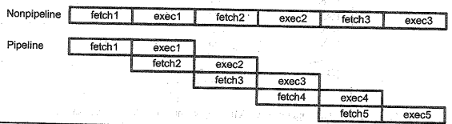
Pipelining
The idea of pipelining is to allow CPU to fetch and execute at the same time.

Slide 17
Instruction Queue and Branch Penalty
Pipelining is widely used in today’s HCS12
Relies on a buffer to hold pre-fetched instructions
The buffer will be cleared on a branch or call instruction
The CPU needs to the new instructions are fetched from the subroutine
This is called a branch penalty
Number of clock cycles in condition branch depends on status bit
No branch, 1 clock cycle
Branch, 3 clock cycles
On another note, differing addressing modes may take different clock cycles for the same command

Slide 18
ADDA Instruction Cycle Times in HCS12/9S12 Datasheet
Addressing Mode | Access Detail | Clock Cycles
Immediate | P | 1
Direct | rPf | 3
Extended | rPo | 3
Indexed no Offset | rPf | 3
Indexed 1 – 9 bit signed offset | rPo | 3
Indexed 2 – 16 bit singned offset | frPP | 4
Indexed Indirect 2 | fIfrPf | 6
Indexed D | fIPrPf | 6
Notes:
I

Slide 19
Access Description
f – free cycle CPU does not use bus
r – read indirect pointer
P – program word fetch, always an aligned word
o – optional program word fetch
l – read indirect pointer

Slide 20
How to estimate delay loop interval
; Estimate the length of a delay loop for a crystal frequency of 5 MHz
MYREG EQU #$1208 ; USE LOCATION 1208 AS COUNTER
DELAY LDAA #200 ; 1 CLOCK CYCLE
STAA MYREG ; 3 CLOCK CYCLE
AGAIN NOP ; 1 CLOCK CYCLE
NOP ; 1 CLOCK CYCLE
DEC MYREG ; 4 CLOCK CYCLE
BNE AGAIN ; 3 CLOCK CYCLE
; HCS12 USES ½ OF OSCILLATOR FREQUENCY FOR CPU INSTRUCTION TIME OR 2.5 MHz
; TIME IS INVERSE OF FREQUENCY OR 0.4 MICROSECONDS
; THE AGAIN LOOP USES 9 CYCLES PER LOOP FOR 200 LOOPS
; TOTAL TIME IS 200 X 9 X 0.4 OR 720 MICROSECONDS

Slide 21
Bottom Line
Use timers for more accurate software generated delays
This is covered in detail in Chapter 9

